Slide 1
Moudel 1 - Introduction to Data Acquisition

Slide 2
Table of Content
• Overview of Digital Forensics & Its Process
• Definition of Data Acquisition
• Types of Data Acquisition
• Order of Volatility
• Copy vs Cloning vs Imaging
• Image file formats
• Risks During the Acquisition Process

Slide 3
Introduction to Digital Forensics
• Digital Forensics is the science of collecting, preserving, analyzing, and presenting digital evidence.
• The goal is to understand what happened during a security incident while maintaining evidence integrity.
• Used in cases such as breaches, data exfiltration, malware infections, or suspicious activity.
• The Digital Forensics Investigator acts like a digital detective.
• Key questions: - How did the attack start? - What actions did the attacker perform? - What systems were affected? - Was there lateral movement or pivoting?
• SANS definition focuses on identification, collection, preservation, analysis, and documentation of digital evidence.

Slide 4
Digital Forensics in Cybersecurity Operations
• Digital Forensics is closely related to Incident Response (DFIR).
• Usually performed within SOC environments (SOC Level 3 / Incident Response teams).
• Helps understand attacker behavior and identify root cause.
• Common investigation scenarios: - Insider threats - External attackers - Malware or backdoors - Suspicious downloads or user activity
• Digital evidence is often latent (not directly visible).
• Investigations rely on artifacts such as: - Logs - Network traffic - SIEM alerts - Disk data

Slide 5
Evidence Handling & Investigation Principles
• Evidence must be collected and preserved without modification.
• Investigations must rely on direct evidence, not assumptions.
• Analysis results should be reproducible and validated by multiple analysts or tools.
• Evidence integrity must be verified using hashing.
• Document the digital crime scene: - Photos - Video recording - System state capture • Perform E-Discovery to identify and collect electronically stored information (ESI). • Final output: Digital Forensics Report containing findings, tools used, and supporting evidence.

Slide 6
E-Discovery
• E-Discovery stands for Electronically Stored Information (ESI).
• It refers to any data or information stored digitally on devices.
• Any data stored on hard disks, servers, or databases is considered part of E-Discovery. • E-Discovery is the process of identifying and collecting digital data that may serve as evidence during an investigation.
• This includes filtering data and extracting all relevant generated data related to the incident, such as: - Database data - Files stored on hard disks - Data stored on servers • The main goal of E-Discovery is to collect digital evidence in an organized way so it can be used later in analysis, investigation, or legal proceedings.

Slide 7
Timeline Analysis in Digital Forensics
• Timeline is a key concept in digital forensics investigations. • It represents the sequence of events over time during an incident. • When collecting evidence, we focus on specific time windows instead of collecting unnecessary data. • Example: - If the attack happened at 8 PM, the priority is to collect data around that period (e.g., 7 PM – 9 PM). • Timeline data is often represented visually to show activity patterns and traffic peaks. • Time standardization is important: - Always use UTC (Universal Time Coordinated) as a reference. - Convert later to local time zones if needed. • Using UTC avoids confusion caused by time zone differences and helps investigators correlate events accurately. • Timeline analysis helps investigators organize, correlate, and understand events during an investigation.

Slide 8
Reviewing Logs & Network Traffic
• Event Logs Review
• Network Traffic Analysis
• Local vs Centralized Logging
• Security Appliances: - Firewall - Proxy - Router - Switch
• Event Correlation

Slide 9
Brief History of Digital Forensics
• Digital Forensics started around 1984 within Law Enforcement agencies.
• Early work relied on individual experience without clear standards or legal frameworks. • Around 1990: - First laws and regulations for handling digital evidence began to appear. • 1998: - ACPO (UK) released early guidelines for digital evidence collection and handling. • Evolution: - 1984 → Early experimentation - 1990 → Legal regulation - 1998 → Standardized procedures • Over time, Digital Forensics evolved into a structured discipline and later expanded into DFIR.

Slide 10
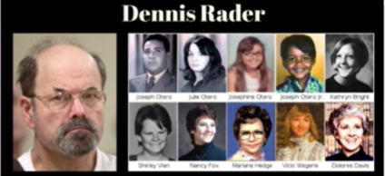
Digital Forensics Case Example (BTK Killer)
• One of the famous cases showing the importance of Digital Forensics is the BTK Killer case. • Dennis Rader, a serial killer active between 1974–1991, sent messages to media and police. • In 2005, he sent a Floppy Disk to the police. • Investigators recovered deleted files and analyzed file metadata. • Metadata revealed: - Deleted Word documents - References to Christ Lutheran Church - Last modified by a user named “Dennis” • Investigators linked the metadata to Dennis Rader and identified him. • Key Lesson: - Digital evidence and metadata analysis can play a critical role in solving real investigations.

Slide 11
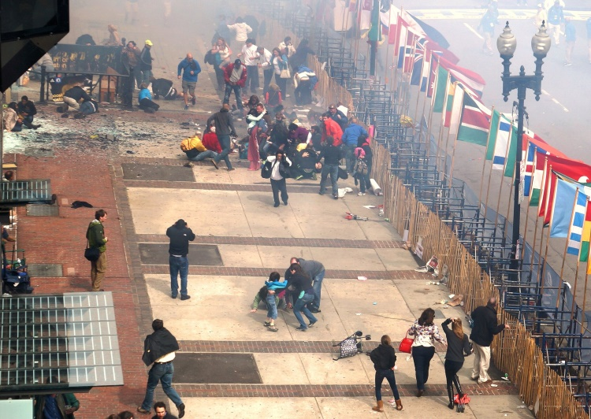
Digital Forensics Case Example (Boston Marathon Bombing)
• Boston Marathon Bombing (USA, 2013) is another major case highlighting the role of Digital Forensics. • During the marathon, two explosions occurred causing multiple casualties and injuries. • Challenge: - Thousands of people were present. - Suspects were initially unknown. • Investigation relied heavily on digital evidence: - CCTV footage - Photos from attendees - Mobile phone videos - Other digital data sources • Investigators analyzed large amounts of media by: - Frame-by-frame video analysis - Tracking movements of individuals - Comparing images from different angles - Building a timeline of events - Investigators identified and tracked the suspects using digital evidence.

Slide 12
Digital Forensics & Incident Response (DFIR)
• DFIR = Digital Forensics + Incident Response. • Both work together to investigate security incidents. • Incident Response: - Fast analysis - Contain and stop the attack - Quick root cause identification • Digital Forensics: - Deep investigation - Focus on evidence and understanding the incident • Shared areas: - Evidence collection - Evidence preservation • Proper evidence handling is important for legal investigations.

Slide 13
Digital Forensics & Threat Hunting
• Threat Hunting is a key function inside the SOC.
• Goal: search for hidden threats that monitoring tools may miss. • Similarity: - Both use hypotheses and evidence to investigate activity. • Difference: - Threat Hunting focuses on detection and discovery. - Digital Forensics focuses on evidence preservation and investigation. • Digital Forensics requires proper evidence handling to maintain credibility and prevent claims of tampering.

Slide 14
Digital Forensics & Malware Analysis
• Malware Analysis: - Analyzes malware behavior. - Requires proper acquisition and extraction (memory, files, network traffic). • Investigation Collaboration (Investigation Triad): - Digital Forensics - Incident Response / SOC - Vulnerability & Risk Management • Roles: - Vulnerability/Risk teams validate system security and reduce investigation assumptions. - SOC / Incident Response provides logs, alerts, and detection data (SIEM, EDR, NDR). - Digital Forensics collects and analyzes reliable evidence. • Key Idea: - Digital investigations are team efforts. - Digital Forensics connects and validates evidence across all domains.

Slide 15
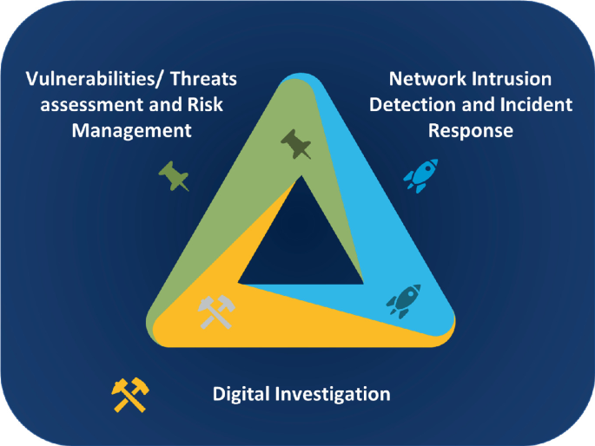
Investigations Triad
• Investigations Triad = 3 teams working together to complete an investigation. • 1) Vulnerability & Risk Management - Validate system security and integrity. - Confirm patches, testing, and reduce investigation assumptions. • 2) Incident Response / SOC - Provide initial evidence. - Logs, alerts, and detection tools (SIEM, EDR, NDR). - Help identify suspicious activity and attacker behavior. • 3) Digital Forensics - Collect and analyze evidence. - Build conclusions based on verified data. • Key Idea: - Digital investigations are collaborative. - The Forensics Investigator works with other teams to reach the full picture of the incident.

Slide 16
Exercise :
• Read the resources below the video.
• If there is any unclear information, search for it.

Slide 17


Thanks for Watching
Contact: 0xgbreil

